Slide 1

Comparative Analysis of Image Classification Algorithms
Based on Traditional Machine
Learning and Deep Learning
Group No. - 10
SHADMAN AHMAD NAFEE_20341033
JANNATUS SAKIRA KHONDAKER_20301468
FAHIM IRFAN AHMED_20101508
RA - SANIA AZHMEE BHUIYAN
ST - MEHNAZ ARA FAZAL

Slide 2



# Introduction
The field of image data classification has seen significant advancements with the advent of machine learning and deep learning algorithms
These algorithms have been instrumental in achieving high accuracy rates in tasks such as object detection, image segmentation, and image recognition
In this study, we compare the performance of a traditional ML algorithm, XGBoost, with two DL algorithms, ResNet50 and EfficientNet-B0, on a 2GB image dataset of Hand Gesture Recognition

Slide 3
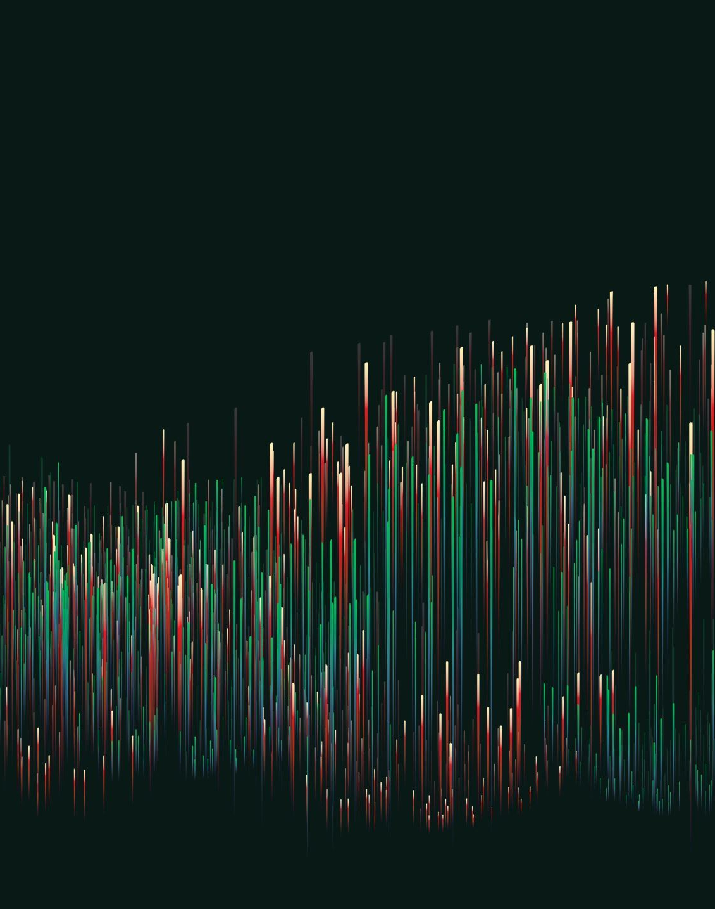
# Background
Traditional ML algorithms like XGBoost have been used for various classification tasks
However, with the advent of DL, models like ResNet50 and EfficientNet have become popular for image classification tasks due to their ability to learn hierarchical features from the data

Slide 4
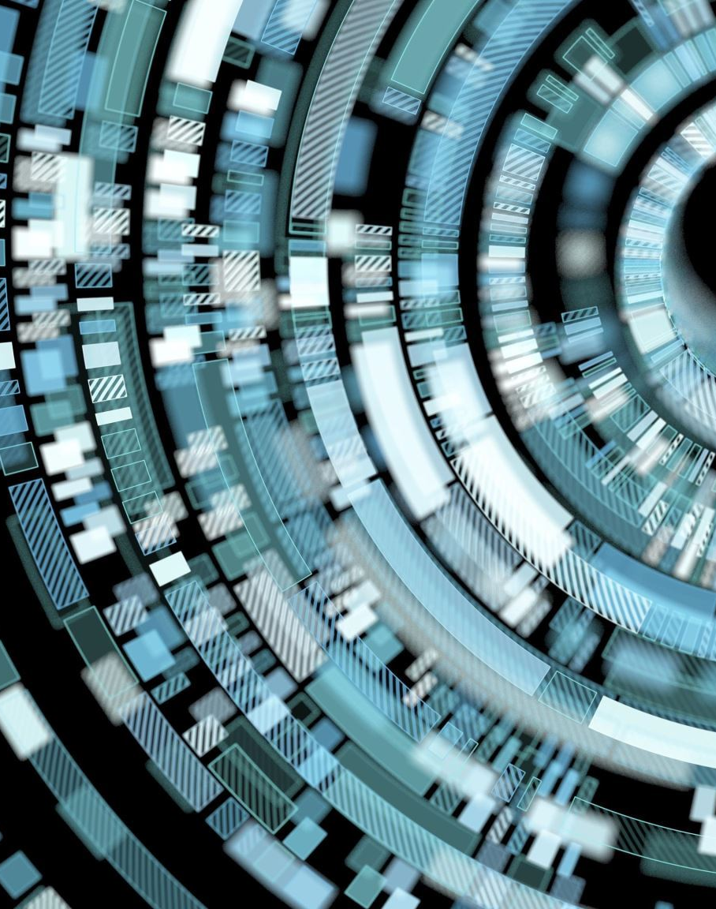
# Applications
ML and DL algorithms have found applications in various fields such as healthcare , autonomous vehicles , security , and agriculture , among others
In this study, we focus on the application of these algorithms in the field of Hand Gesture Recognition

Slide 5
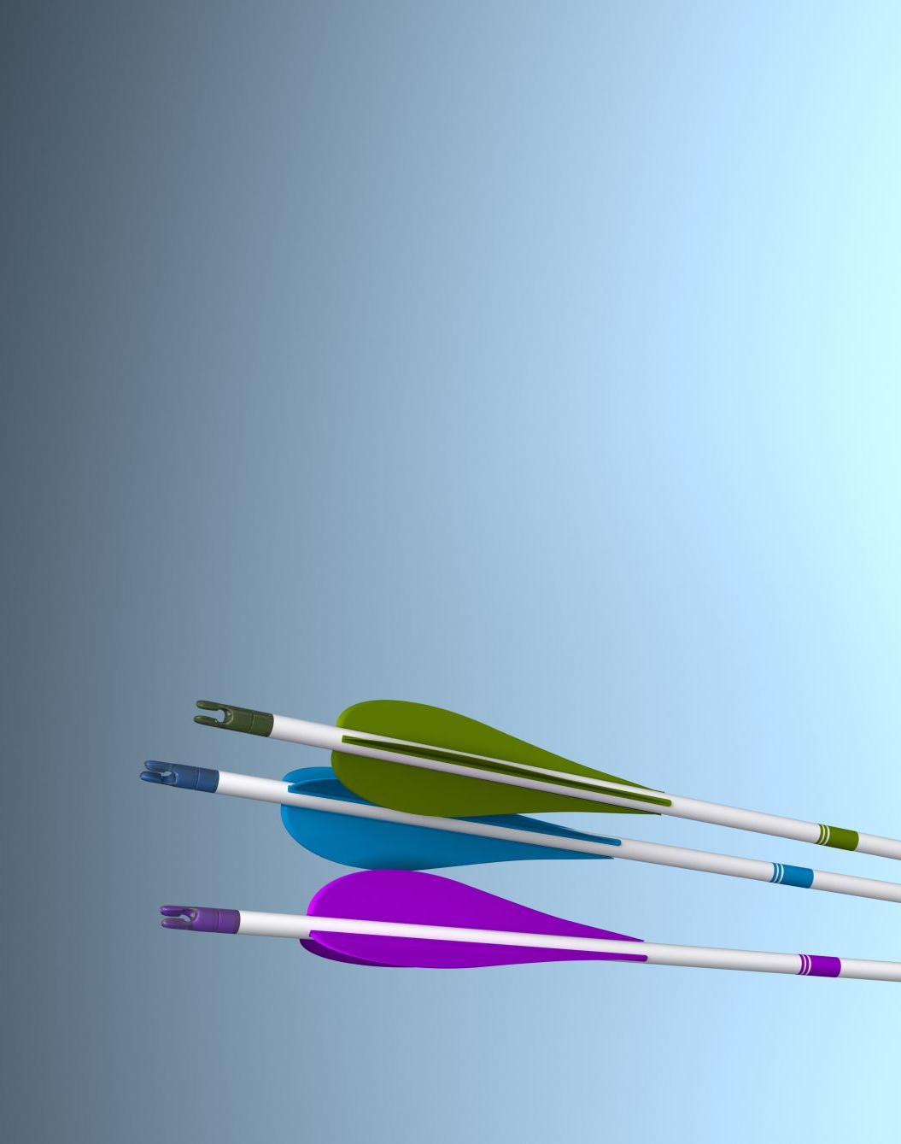
# Ideas
The idea is to compare the performance of XGBoost, ResNet50, and EfficientNet-B0 on image data
This involves training these algorithms on the same dataset and evaluating their performance based on metrics such as accuracy

Slide 6
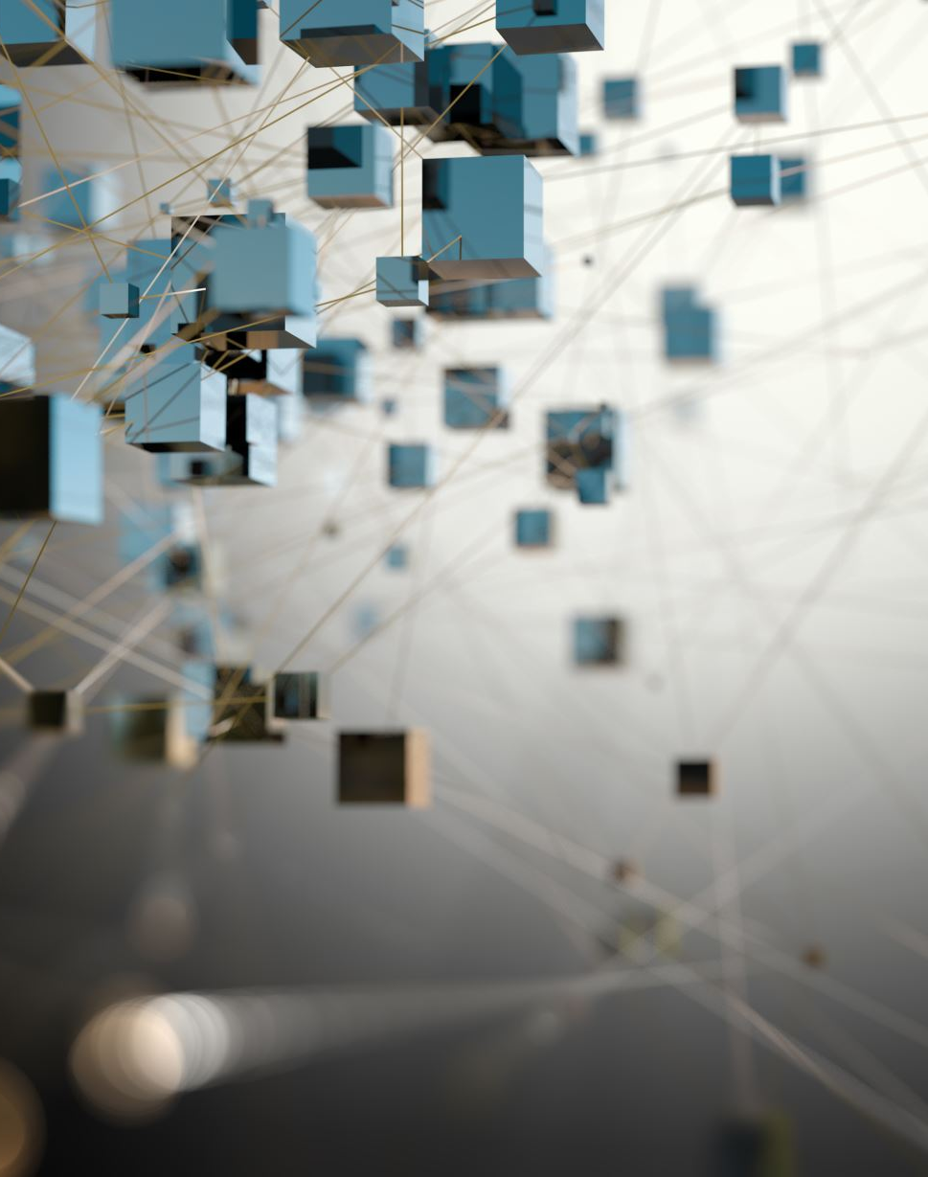
# Challenges
The main challenges in this study include handling high-dimensional image data, overfitting, computational resources, and the interpretability of DL models

Slide 7




# Methodologies
The dataset consisted of hand gesture images from 10 classes, with gestures from 5 men and 5 women
Preprocessing: We normalized and augmented the data to make it suitable for the ML and DL algorithms
Model Selection and Training: We selected XGBoost, ResNet50, and EfficientNet-B0 as our models for comparison
Pre-trained models are advantageous as they have already learned useful features from large datasets, which can be leveraged for our specific task

Slide 8

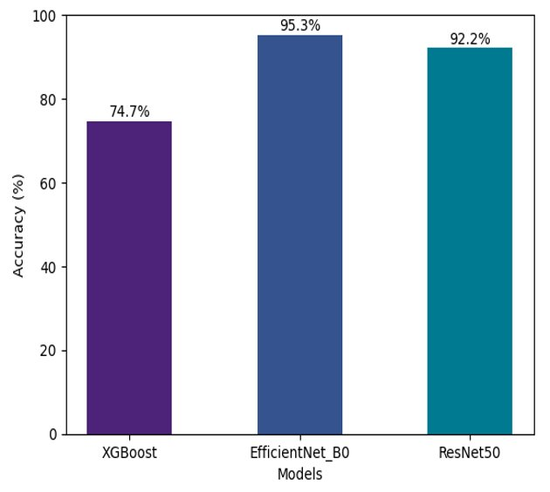


# Conclusion
In our study, we found that the DL models outperformed the ML model
The test accuracies for XGBoost, ResNet50, and EfficientNet-B0 were 74.7%, 92.75%, and 95.3% respectively
This suggests that DL models like ResNet50 and EfficientNet-B0 are more suitable for image classification tasks compared to traditional ML models like XGBoost

